Slide 2
Objectives Overview
Identify the qualities of valuable information
Describe various information systems used in an enterprise
Identify the components of and steps in information literacy
Describe career opportunities available in various segments of the computer industry
Identify job titles and responsibilities for various technology jobs
See Page 552
for Detailed Objectives

Slide 3
Objectives Overview
Identify mobile app development strategies
Identify ways to prepare for certification
Describe the general areas of IT certification
Identify ways to begin a job search
Explain how to create a professional online presence
See Page 552
for Detailed Objectives

Slide 4
The Technology Industry
Nearly every jo requires you to interact with technology to:
Complete projects
Exchange information with coworkers
Meet customers’ needs
As new technologies emerge, organizations look for potential employees who possess skills and a desire to learn and who are comfortable using all types of technology
Page 552

Slide 5

The Technology Industry
Page 553
Figure 12-1

Slide 6
Information Systems in the Enterprise
An information system is a set of hardware, software, data, people, and procedures that work together to produce information
To assist with sound decision making, information must have value
Page 554

Slide 7
Information Systems in the Enterprise
For information to be valuable, it should be:
Accurate
Verifiable
Timely
Organized
Accessible
Useful
Cost effective
Page 554

Slide 8
Information Systems in the Enterprise
A typical enterprise consists of a wide variety of departments, centers, and divisions — collectively known as functional units
Human Resources (HR)
Engineering or Product Development
Manufacturing
Marketing
Sales
Customer Service
Pages 554 - 555

Slide 9
Information Systems in the Enterprise
Enterprise Resource Planning (ERP) integrates MRP II with the information flow across an organization to manage and coordinate the ongoing activities of the enterprise
Product planning
Manufacturing and distribution
Accounting and finance
Sales
Human resources
Customer support
Page 555

Slide 10
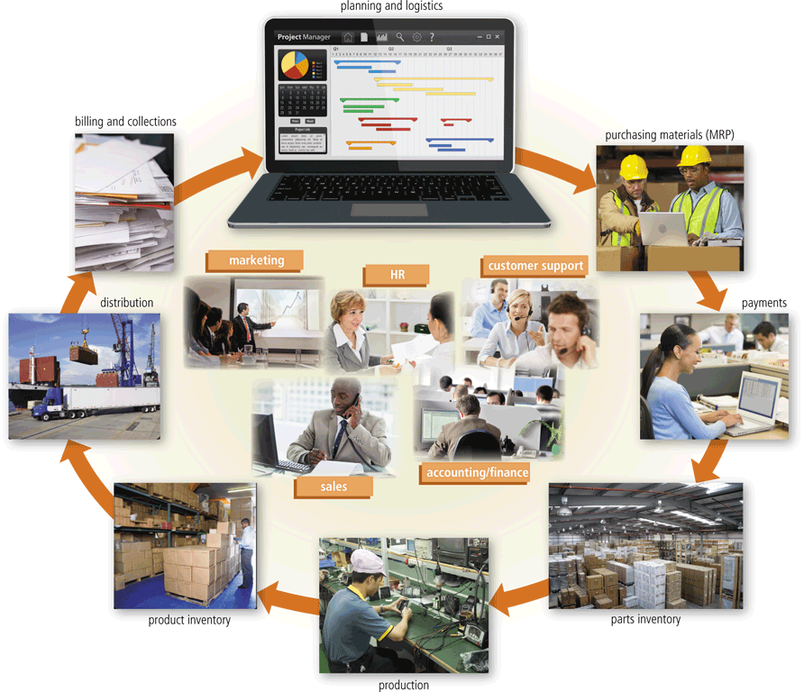
Information Systems in the Enterprise
Page 556
Figure 12-2

Slide 11
Information Systems in the Enterprise
Document Management System (DMS)
Allows for storage and management of a company’s documents
Content Management System (CMS)
Enables and manages the publishing, modification, organization, and access of various forms of documents and other files
Supports access control, security, version tracking, and search
Provides security controls
Content added through a graphical user interface or webpage
Pages 556 - 557

Slide 12
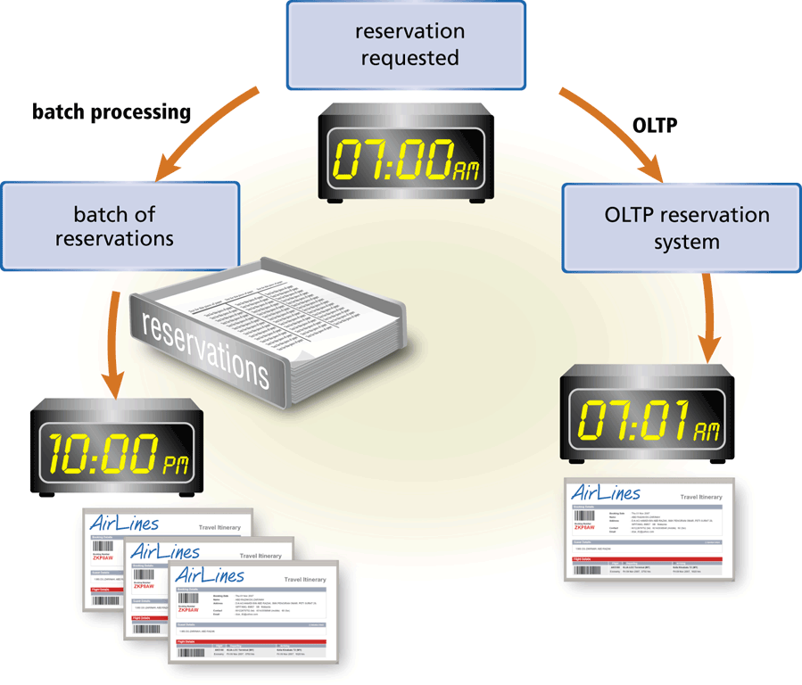
Information Systems in the Enterprise
A transaction processing system (TPS) is an information system that captures and processes data from day-to-day business activities
Online transaction processing (OLTP)
Pages 557 – 558
Figure 12-3

Slide 13
Information Systems in the Enterprise
A management information system (MIS) is an Information system that generates accurate, timely, and organized information, so that managers and other users can make decisions, solve problems, supervise activities, and track progress
Page 558

Slide 14
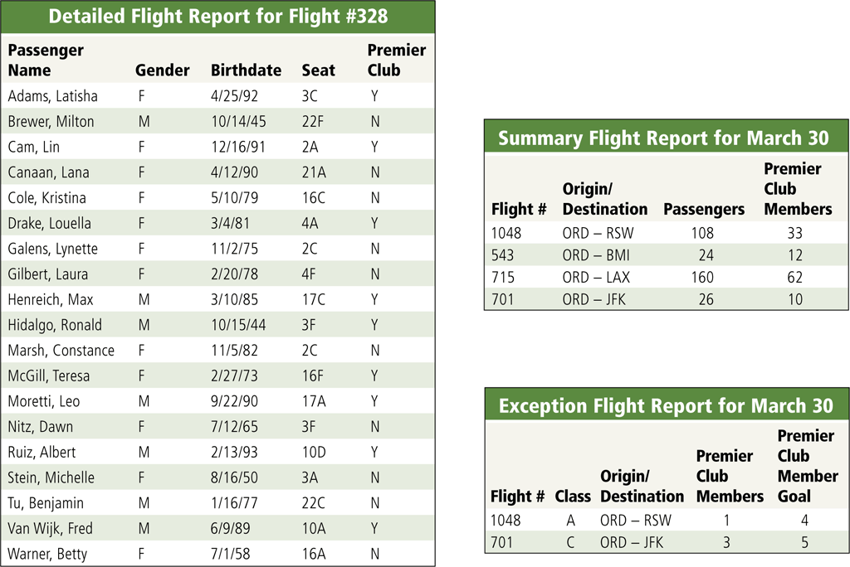
Information Systems in the Enterprise
Page 559
Figure 12-4

Slide 15
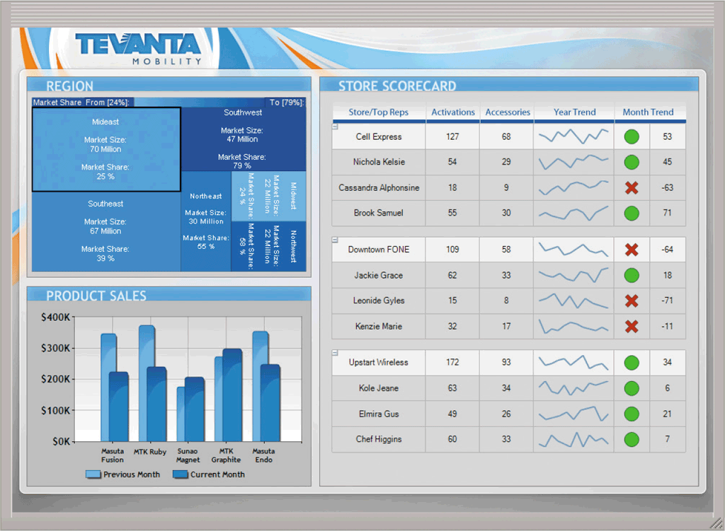
Information Systems in the Enterprise
A decision support system (DSS) helps users analyze information and make decisions
Online analytical processing (OLAP)
Page 559
Figure 12-5

Slide 16
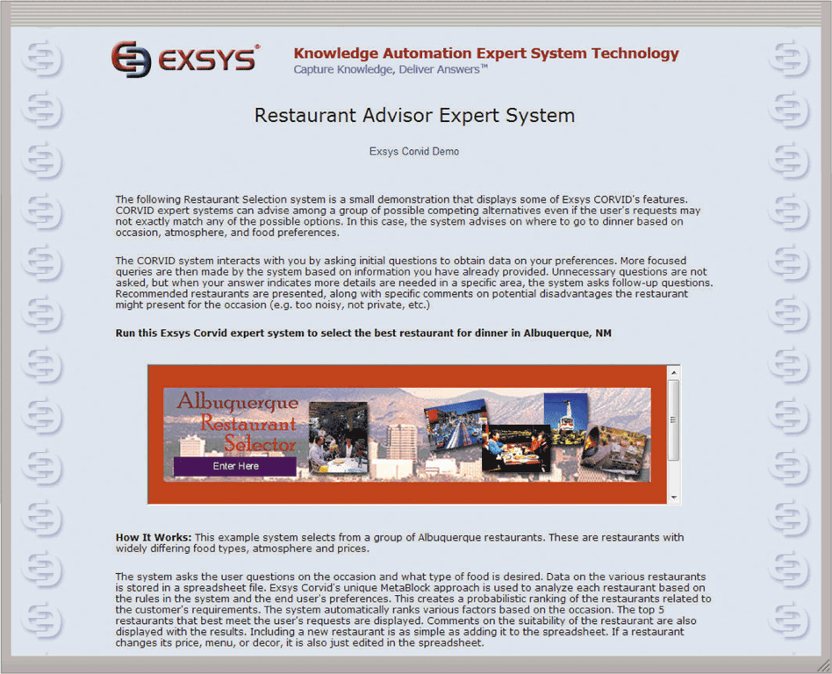
Information Systems in the Enterprise
An expert system is an information system that captures and stores the knowledge of human experts and then imitates human reasoning and decision making
Page 560
Figure 12-6

Slide 17
Technology Careers
Business and government organizations of all sizes use a variety of computers, mobile devices, and other technology
Larger organizations use computers and other technology to answer and route phone calls, process orders, update inventory, and manage accounts receivable, accounts payable, billing, and payroll activities
Page 562

Slide 18
Technology Careers
IT jobs usually are divided into the following areas:
Management
Research and software development
Technical support services
Operations
Training/Support
Information security services
Marketing/Strategy
Page 564

Slide 19

Technology Careers
The technology equipment field consists of manufacturers and distributors of computers, mobile devices, and other hardware, such as magnetic and optical drives, monitors, printers, and communications and networking devices
The software and apps field consists of companies that develop, manufacture, and support a wide range of software and apps for computers, the web, and mobile devices
Page 564
Figure 12-8

Slide 20
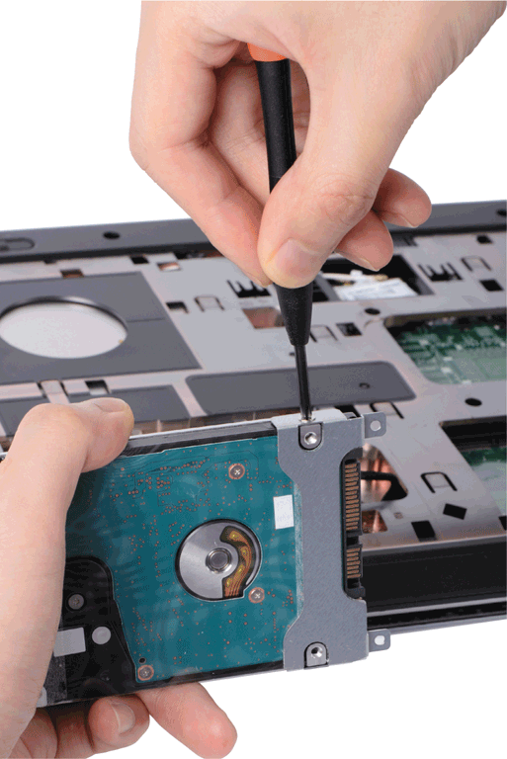
Technology Careers
The technology service and repair field provides preventive maintenance, component installation, and repair services to customers
Page 565
Figure 12-9

Slide 21

Technology Careers
Technology salespeople must possess a general understanding of technology and a specific knowledge of the product they are selling
Page 566
Figure 12-10

Slide 22

Technology Careers
Schools, colleges, universities, and private companies all need qualified educators to provide technology-related education and training
Corporate trainers teach employees how to use software and apps, design and develop systems, write programs, integrate and sync data from apps used on multiple devices, and perform other technology-related activities
Page 567
Figure 12-11

Slide 23
Technology Careers
A help desk specialist answers hardware, software, and networking questions in person, over the phone, or electronically via email or a chat room
An IT consultant, typically hired based on expertise, provides technology services to his or her clients
Pages 567 - 568

Slide 24
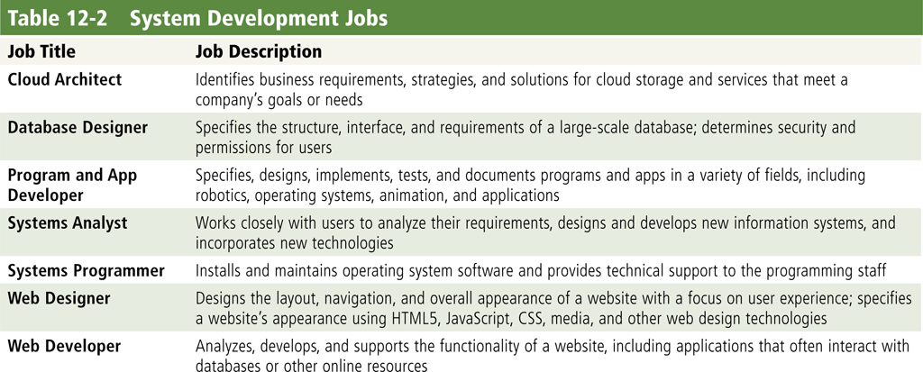
Technology Careers
Page 568
Table 12-2

Slide 25
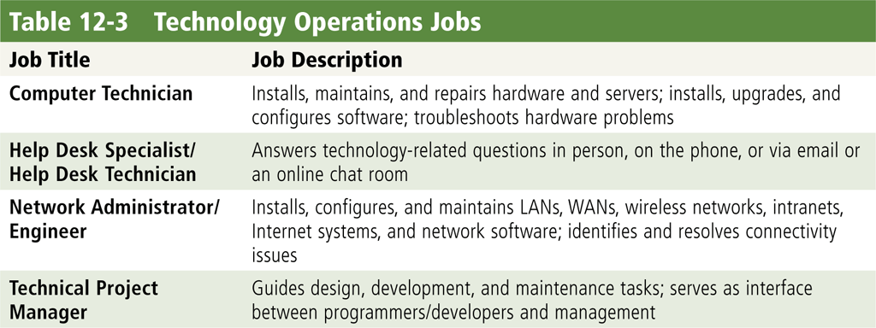
Technology Careers
Page 569
Table 12-3

Slide 26
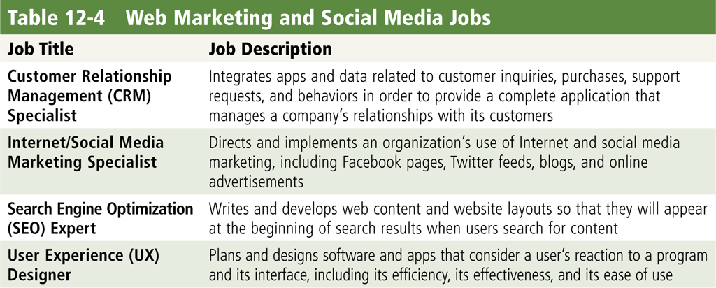
Technology Careers
Page 569
Table 12-4

Slide 27
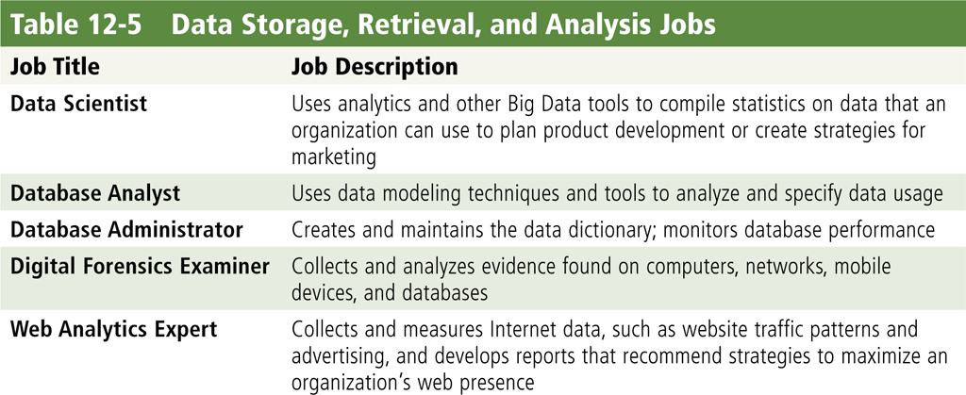
Technology Careers
Page 569
Table 12-5

Slide 28
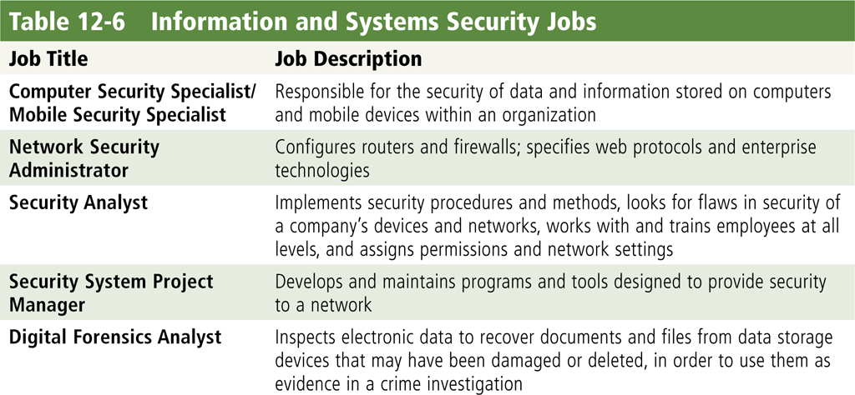
Technology Careers
Page 570
Table 12-6

Slide 29
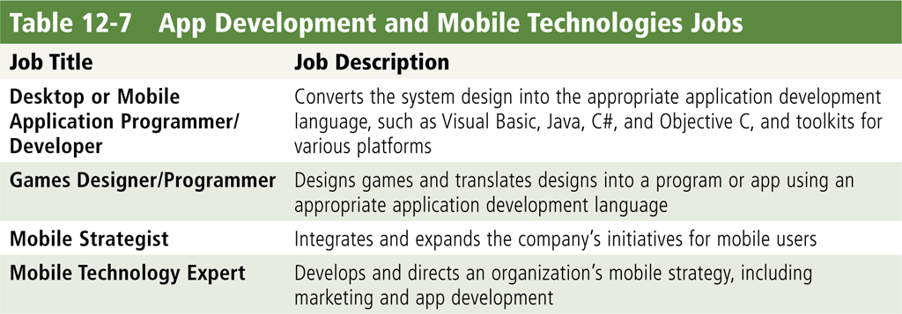
Technology Careers
Page 570
Table 12-7

Slide 30
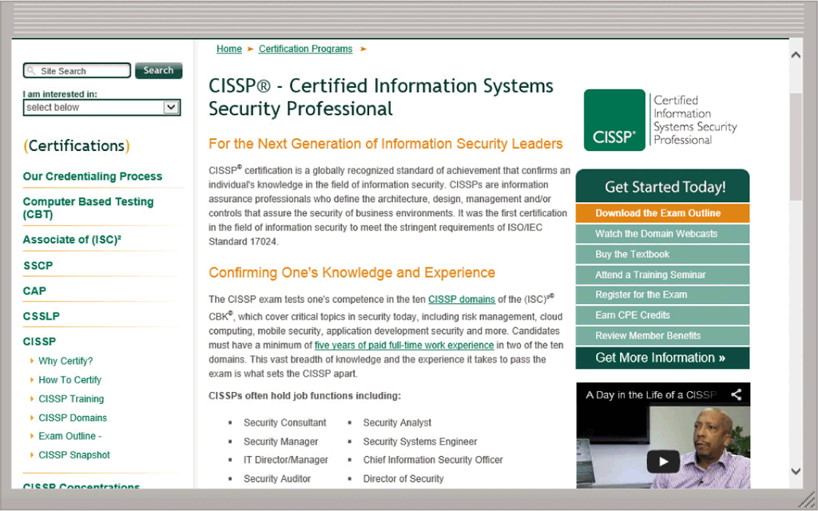
Technology Certifications
A certification demonstrates your knowledge in a specific area to employers or potential employers
Obtaining a certification requires time and money
Page 572
Figure 12-12

Slide 31
Technology Certifications
Application Software Certifications
Corporate trainers
Help desk specialists
Office managers/workers
Technology sales representatives
Technology teachers
Page 572

Slide 32
Technology Certifications
Data Analysis and Database Certifications
Data scientist
Database administrators
Database analysts
Digital forensics examiners
Page 573

Slide 33
Technology Certifications
Hardware Certifications
Cable installation technicians
Computer repair technicians
Corporate trainers
Help desk specialists
IT consultants
System engineers and administrators
Page 573

Slide 34
Technology Certifications
Networking Certifications
Hardware service technicians
IT consultants
Network managers
Network engineers
System administrators
Page 573

Slide 35
Technology Certifications
Operating System Certifications
Hardware technicians
Help desk specialists
Network administrators
IT consultants
System administrators
Page 574

Slide 36
Technology Certifications
Program/Developer Certifications
Game developers
IT consultants
Mobile application developers
Project leaders/managers
Systems analyst
Web developers
Page 574

Slide 37
Technology Certifications
Security Certifications
Information security officers and managers
Law enforcement officials
Military intelligence officers
Network administrators
Wireless network administrators
Network security specialists
Security administrators
Page 575

Slide 38
Job Searching and Career Planning
Many job opportunities may exist in your industry, so it is important to narrow down the available jobs to ones for which you are qualified and in which you are interested
Tools at your disposal include the career service department at your school, career planning websites, and online social networks
Whether you are seeking a new job or currently are employed, you may find a career planning website useful
Page 576

Slide 39
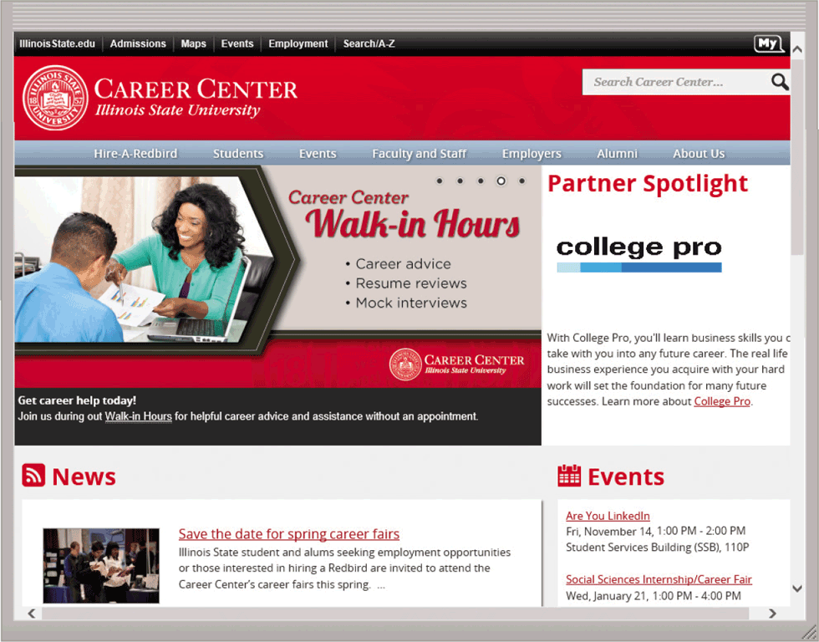
Job Searching and Career Planning
Page 576
Figure 12-13

Slide 40
Summary
Information systems in an enterprise
Various technology career fields and specific technology jobs
Technology certifications
How to begin a job search and create a professional online presence
Page 579

Slide 41
Chapter 12 Complete

